Slide 1
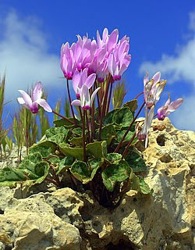
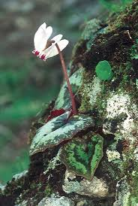
Cyclamen cyprium
Agios Dometios 2
nd
Elementary School (K.A’) Erasmus+ “We care about our planet” 2019-
2020

Slide 2
Cyclamen cyprium (Cyprus cyclamen)
It is the national flower of Cyprus
There are three kinds of Cyclamen found in Cyprus:
Cyclamen persicum
Cyclamen graecum
Cyclamen Cyprium
Only the Cyclamen Cyprium is endemic.
Agios Dometios 2
nd
Elementary School (K.A’) Erasmus+ “We care about our planet” 2019-
2020

Slide 3
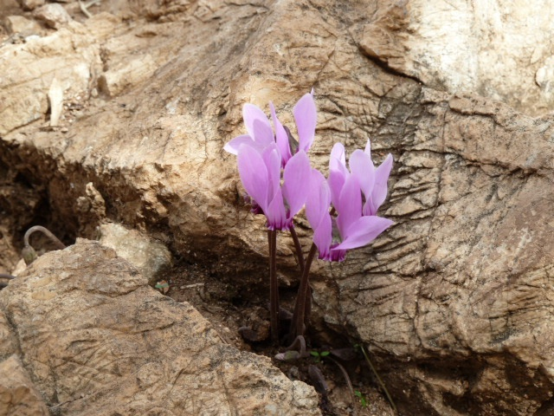
General Information about Cyclamen Cyprium
It is a perennial growing from a tuber, native to woodland at 300–1,200 m (980–3,940 ft) elevation in the mountains of Cyprus.
It grows in cool and wet areas, near rivers, among rocks, trees and bushes and in shady places.
It grows from September up to January.
You can find it in Troodos and Pentadaktylos, the two mountains of Cyprus.
It is the national plant of Cyprus and it′s a protected species by the government law and CITES ( Convention on international Trade in Endangered Species of Wild Fauna and Flora.)
Agios Dometios 2
nd
Elementary School (K.A’) Erasmus+ “We care about our planet” 2019-
2020

Slide 4
General Information about Cyclamen Cyprium
The cyclamen is so important for the Flora of Cyprus, and it is set as one of the national emblem since 2006. For this reason it is shown on some post stamps.
The cyclamen flower wither during summer months and come to live again from September until Spring.
Agios Dometios 2
nd
Elementary School (K.A’) Erasmus+ “We care about our planet” 2019-
2020

Slide 5
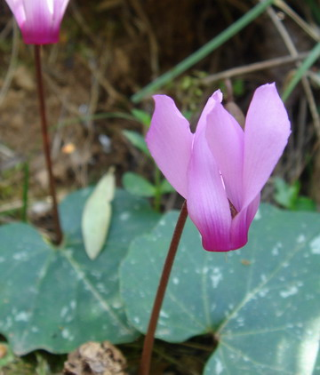
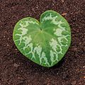
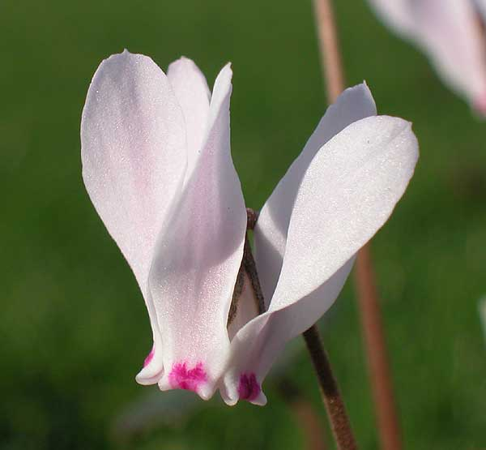
Description
The leaves of the cyclamen are heart-shaped with coarsely toothed edges, green variegated with blotches of silver above and purple beneath.
Flowers bloom in autumn to winter and they have 5 upswept petals, white to pale pink with a magenta blotch near the nose. The bases of the petals curve outwards into auricles.
After pollination, flower stems curl, and seeds are borne in round pods, opening by 5 flaps when mature.
The height of the cyclamen reaches up 7-15cm tall.
Agios Dometios 2
nd
Elementary School (K.A’) Erasmus+ “We care about our planet” 2019-
2020

